Slide 1
Söderåsen Sommarkampanj
1/9/2021

Slide 2
Total campaign statistics (jun 29 – aug 31)
Impressions: An impression is counted each time your ad is shown on a search result page, site on the Google Display Network.
Clicks: When someone clicks on your ad.
Awareness
Engagement
Conversion
3 710 866 impressions
25 623 clicks
Media cost (incl. 5%): 21 059 SEK

Slide 3
Google Ads Display

Slide 4
Google Ads Ad groups

Slide 5
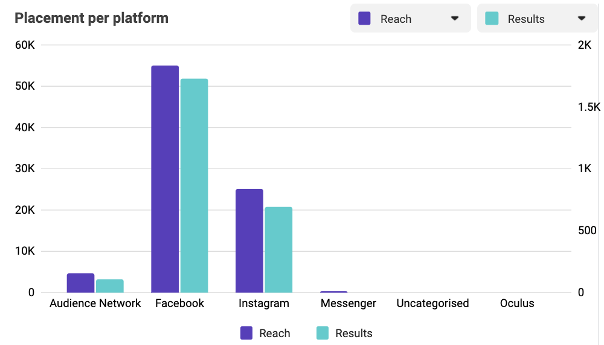
Facebook & Instagram

Slide 6
Insights
Increased amount of impressions and clicks compared to spring campaigns.
Good click through rate on both Google Ads Display campaigns. “Bo över” generated the highest CTR.
The majority of impressions come from Google Ads Display campaign “Aktiviteter”, most of them from the ad group targeting “Barnfamiljer”.
"Utomhusaktiviteter" performed better than "Barnfamiljer" on Facebook & Instagram.

