Slide 1
Söderåsen vårkampanj
7/2/2021

Slide 2
Total campaign statistics (May 26 – July 1)
Impressions: An impression is counted each time your ad is shown on a search result page, site on the Google Display Network.
Clicks: When someone clicks on your ad.
Awareness
Engagement
Conversion
1 507 595 impressions
7 741 clicks
Media cost (incl. 5%): 8 146 SEK

Slide 3
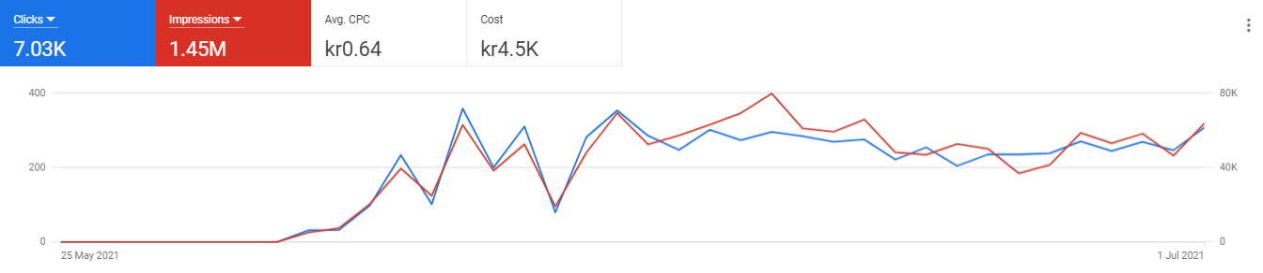
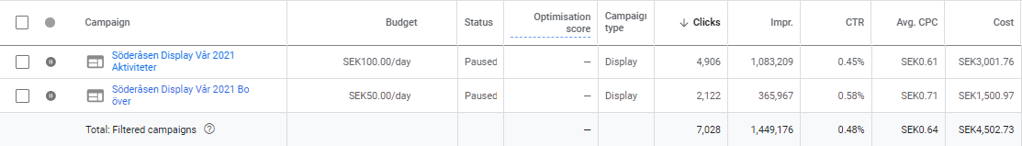
Google Ads Display

Slide 4
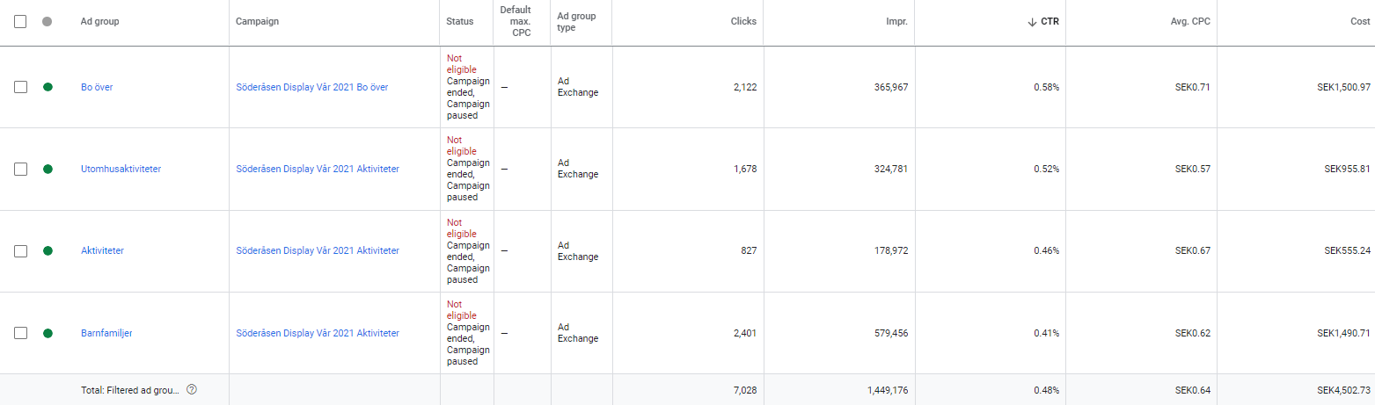
Google Ads Ad groups

Slide 5
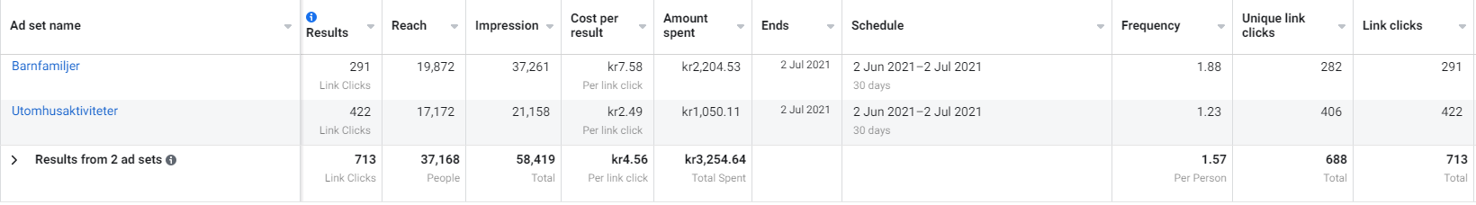
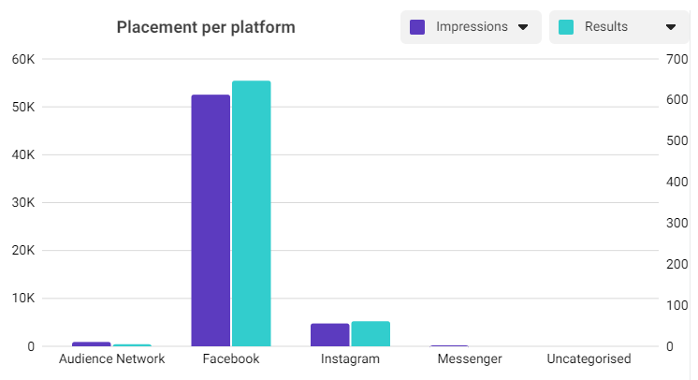
Facebook & Instagram

Slide 6
Insights
Good click through rate on both display campaigns. “Bo över” generated the highest CTR.
The majority of impressions come from Google ads display campaign “Aktiviteter”, most of them from the ad group targeting “barnfamiljer”.
Facebook performed better than Instagram in terms of impressions.

